Slide 1
Dynamic News Classification
Submitted by
Ashutosh Khurana
(9913103503)
Under the Guidance of
Mr. Sudhanshu Kulshrestha
(Deptt of CSE)

Slide 2
INDEX
Current Open Problem
Problem Statement
Data Collection By Web Scraping
Libraries used for Web Scraping
Why Python ?
Packages of Python
Libraries in Python
Feature Extraction
Implementation of Feature Extraction
Classification Of Documents
Machine Learning Technique – Naïve Bayes
Naïve Bayes Classifier Flow Diagram
Pros and Cons of Naïve Bayes
Use-Case Diagram
Class Diagram
Overall Architecture Diagram
Annotations of Relevant Literature

Slide 3
Results from the Previous Semester
We implemented machine learning techniques to classify articles into fixed categories which were : -
Naïve Bayes
Latent Dirichlet allocation (LDA)
Maximum Entropy
Naïve Bayes gave the most efficient results out of these three.

Slide 4
Current Open Problem
Due to exponential growth of data, it has become a tedious job to search all the data to find a particular category or article.
It would lead us to a time in future where large amount of data would not be able to manage easily.

Slide 5
Continued
Example : When there are large amount of un data containing information about Politics, Sports, Health, Technology etc. and all of these are scattered and the user wants to look at a specific category like Sports so it would become very difficult for him to look through all of the data.

Slide 6
Problem Statement
Researching and Implementing techniques used to tackle the previously mentioned problem
Machine Learning Techniques like Naive Bayes, K-NN & Decision Tree are used to classify News Articles.

Slide 7
IMPLEMENTATION

Slide 8
SOLUTION APPROACH
Articles on the Pre-Defined Category
Web Scraping
Feature Extraction
Classifiers
Article Classification
Classified Article

Slide 9
Data Collection By Web Scraping
The first task of the project was to collect data from internet, for that, a technique called Web Scraping was used.
What is Web Scraping ?
It is a technique employed to extract large amounts of data from websites whereby the data is extracted and saved to a local file in your computer.

Slide 10
3600 articles with 600 in each of the pre-defined categories were collected. The categories were:
Sports
Technology
Business
Health
Politics Entertainment
80% of the dataset was the Training data & remaining 20% of the dataset as Test Data.
Some of the articles were directly downloaded from BBC News, Guardian and Reuters in ‘.txt’ format & other were scraped using Web Scraping techniques

Slide 11
Libraries used for Web Scraping
Python Libraries like BeautifulSoup,Urllib2,
Requests,lxml were used.
Urllib2 : This library was used for fetching URLs.
BeautifulSoup : This library was used for pulling out information from the URLs.
Lxml : This library does the same work as BeautifulSoup.
Requests : Does the same work as Urllib2 but in a more efficient manner

Slide 12
CODE
from bs4 import BeautifulSoup
import requests
url = raw_input("Enter a website to extract the URL's from: ")
r = requests.get("http://" +url)
data = r.text
soup = BeautifulSoup(data)
for link in soup.find_all('a'):
print(link.get('href'))

Slide 13
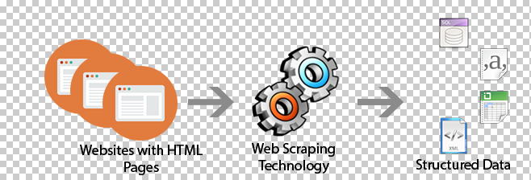
The previous code will fetch all the URLs from the asked website.

Slide 14
Why Python ?
Python has really great XML/HTML parsing libraries such as Beautiful Soup and Scrape.py. You can use these libraries to quickly scrape the web and generate large data sets to improve the performance of your models (because big data trumps complexity)
Scipy + Numpy: everything that isn't in NLTK is definitely in these libraries. If you want to use more advanced algorithms like Latent Dirichlet Allocation, Python has libraries to do that also.

Slide 15
CONCEPTS OF NATURAL LANGUAGE PROCESSING
An in-built Python package called NLTK(Natural Language Tool Kit) was used for Text Processing such as for Tokenization and removing Stop Words
Tokenization : a document is treated as a string and then partitioned into list of tokens
Stop Words : These are the words which are filtered out before or after the processing of natural language data(dropping the common terms). Example : ‘a’,’an’,’the’,’as’,’it’,’be’,’by’,’he’,’in’ etc.

Slide 16
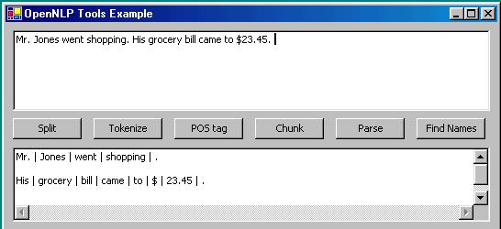
Process of Tokenization

Slide 17
After removing Stop Words and doing Tokenization,various Classifier Techniques can be used to classify the news articles into pre-defined categories like Naïve Bayes,K-NN,SVM,Decision Tree,LDA,Maximum Entropy.
In this project , for the time being, Naïve Bayes has been implemented.

Slide 18
Libraries In Python
Scikit-Learn :
It is a Machine Learning Library for Python Programming Language
Simple and efficient tool for data mining and data analysis
It features various classification algorithms that includes Support Vector Machine,K-NN,Naïve Bayes etc.
It is also used for Feature Extraction

Slide 19
Continued
Natural Language Tool Kit :
NLTK is a leading platform for building Python programs to work with human language data.
It provides easy-to-use interfaces to over 50 corpora and lexical resources.
It includes text processing libraries for classification, tokenization, stemming, tagging, parsing, and semantic reasoning.

Slide 20
Anaconda :
Anaconda is the leading open data science platform powered by Python.
It includes over 100 of the most popular Python, R and Scala packages for data science.

Slide 21
Feature Extraction
It is the transforming of input data into set of features
It involves reducing the amount of resources required to describe a large set of data

Slide 22
Implementation Of Feature Extraction
The sklearn.feature_selection module implements feature selection algorithms which includes Count Vectorizer,TF-IDF Vectorizer and Hashing Vectorizer.
All of the above converts a collection of text documents to a matrix of token counts
Then Feature selection is done, which is to select a sub-set of all the available features.

Slide 23
Classification Of Documents
Classification of documents can be done in 2 ways,i.e. Supervised & Unsupervised Learning.
Supervised Learning : When the class label of each document is known that is called supervised clearning
Unsupervised Learning : when the class label of documents are not known that is called unsupervised classification.

Slide 24
For supervised learning we have trained the classifiers using trained data. We have used Scikit-learn that contained the classifiers.

Slide 25
Machine Learning Techniques
Naïve Bayes
The Bayesian classifiers usually use Supervised Learning on training documents to estimate the parameters of the generative model
Assumption is taken that all the variables are independent of each other(even if they are mutually dependent)
This classifer gives a good accuracy even with smaller amount of data
It is a type of Supervised Learning – i.e. it learns by examples ,the trained data and predicts the category of test data.

Slide 26
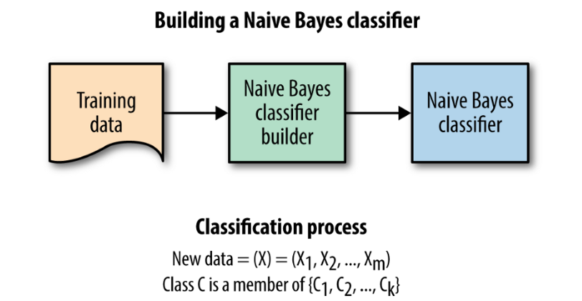
Naïve Bayes Classifier Flow Diagram

Slide 27

P(c|d) is the posterior probability of class (c) given predictor (d). P(c) is the prior probability of class. P(d|c) is the likelihood which is the probability of predictor given class. P(d) is the prior probability of predictor.

Slide 28
Pros and Cons of Naive Bayes
Advantages
It’s relatively simple to understand and build
It’s easily trained, even with a small dataset
It’s fast!
It’s not sensitive to irrelevant features
Disadvantages
It assumes every feature is independent, which isn’t always the case

Slide 29
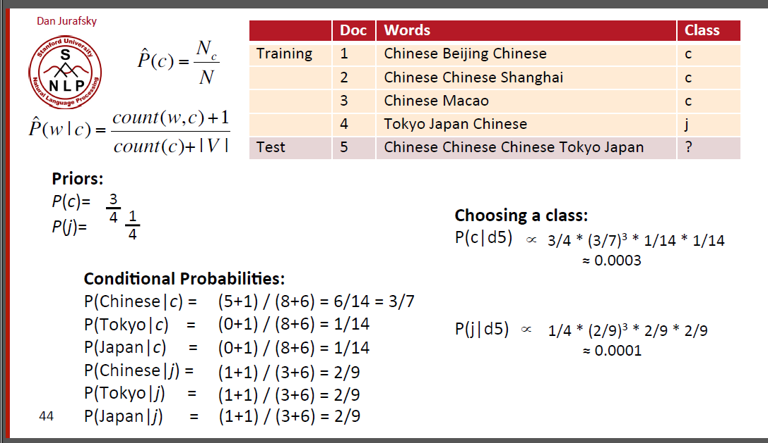
Example Of Naïve Bayes Classifier

Slide 30
K-NN(K- Nearest Neighbour)
K nearest neighbors is a simple algorithm that stores all available cases and classifies new cases based on a similarity measure (e.g., distance functions).
Even with such simplicity, it can give highly competitive results.
Increasing the value of “K” , areas predicting each class will be smoothed and there will be less complexity

Slide 31
Decision-Tree
A decision tree is a flow-chart-like structure like tree structures where leaves represent class labels and branches represent conjunctions of features that lead to those class labels.

Slide 32
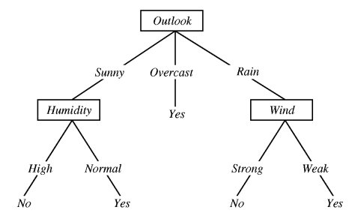
Example of Decision Tree

Slide 33
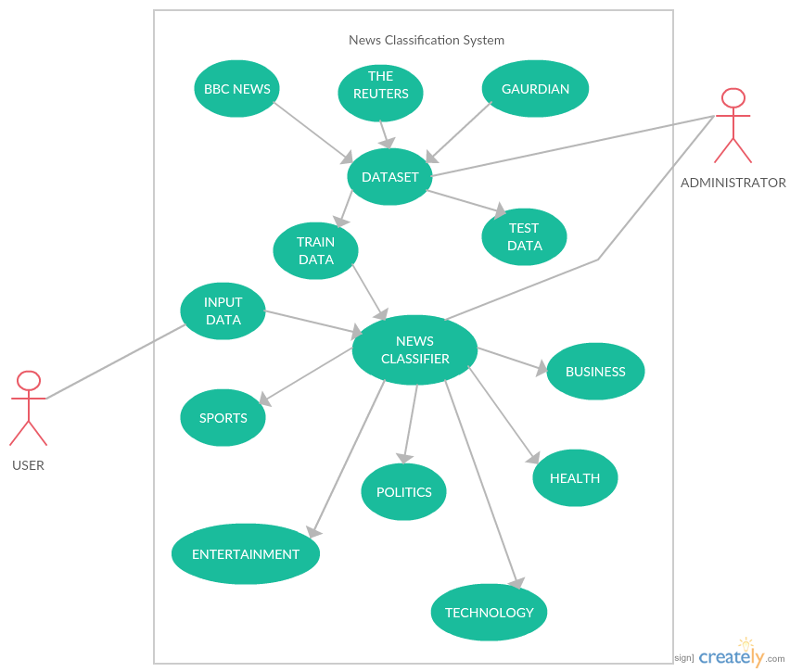
Use-Case Diagram

Slide 34
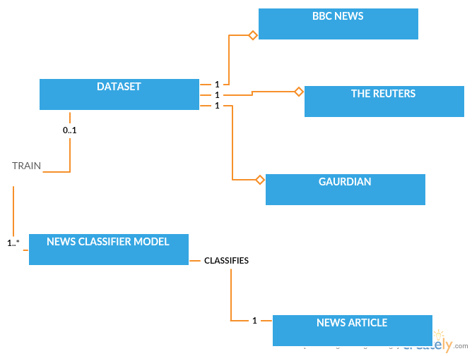
Class Diagram

Slide 35
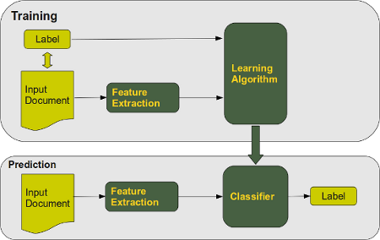
Overall Architecture Diagram

Slide 36
Annotation Of Relevant Literature
[1]Ramdass, Dennis, and Shreyes Seshasai. "Document classification for newspaper articles." (2009).
[2]Kaur, Harmandeep, Sheenam Malhotra, and Fatehgarh Sahib. "Online News Classification: A Review." International journal of Innovation in Engineering and Technology (IJIET) 2.2 (2013).
[3]Bai, Yiqi, and Jie Wang. "News classifications with labeled LDA."
[4]Knowledge Discovery, Knowledge Engineering and Knowledge Management (IC3K), 2015 7th International Joint Conference on. Vol. 1. SCITEPRESS, 2015.
[5]Lam, Wai, and Kei Shiu Ho. "FIDS: an intelligent financial Web news articles digest system." IEEE Transactions on Systems, Man, and Cybernetics-Part A: Systems and Humans 31.6 (2001):
[6]Hakim, Ari Aulia, et al. "Automated document classification for news article in Bahasa Indonesia based on term frequency inverse document frequency (TF-IDF) approach." Information Technology and Electrical Engineering (ICITEE), 2014 6th International Conference on. IEEE, 2014.
[7]Yang, Yiming, et al. "Learning approaches for detecting and tracking news events." (2000).

